Slide 1
Aeration and agitation

Slide 2
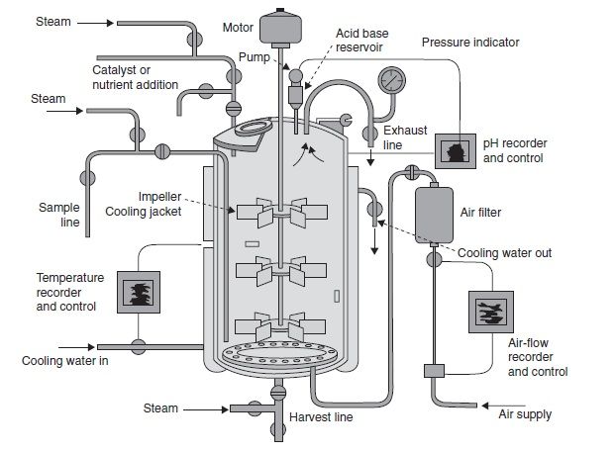
Majority of the fermentation process are aerobic
C₆H₁₂O₆+6O₂ = 6H₂O+6CO₂
But both the components must be in solution before they are available to micro-organism.
O₂ is approximately 6000 times less soluble in water than is glucose
Thus it is not possible to provide a microbial culture with all the oxygen it will need for complete oxidation of the glucose
The oxygen demand of an industrial fermentation process is normally satisfied by aerating and agitating the fermentation broth

Slide 3
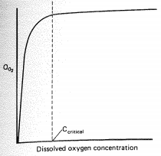
Metabolism of culture is affected by the concentration of dissolved oxygen in the broth.
The effect of dissolved oxygen concentration on the specific oxygen uptake rate (mmmoles of oxygen consumed per gdw of cells per hour) is shown
If the DOC is to fall below the critical level then cells may be metabolically disturbed.
Effect of dissolved oxygen concentration in the Qo2 of a microorganism

Slide 4
Oxygen Supply
Oxygen is normally supplied to microbial cultures in the form of air, this being the cheapest source available
Method for provision of a culture with a supply of air varies with the scale of the process.
Laboratory scale cultures may be aerated by means of shake-flask technique.
Pilot and industrial-scale fermentations are normally carried out in stirred, aerated vessels.

Slide 5
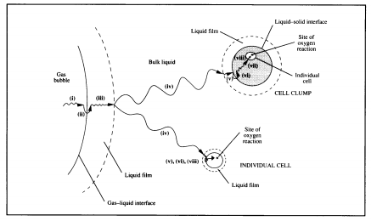
Transfer of oxygen from air to the cell
Transfer of oxygen from an air bubble into solution.
Transfer of the dissolved oxygen through the fermentation medium to the microbial cell.
Uptake of the dissolved oxygen by the cell.
Limiting step in the transfer of oxygen from air to the cell is the transfer of oxygen into the solution.

Slide 6
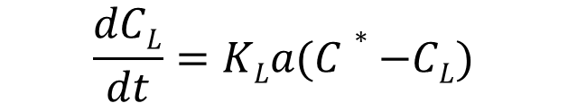
Rate of oxygen transfer from air bubble to the liquid phase
C_{L} = concn. of dissolved oxygen in the fermentation broth (mmoles/dm³)
t= time (h)
dC_{L}/dt = change in oxygen concentration over a time period (oxygen transfer rate (mmoles/dm³/h)
K_{L} = mass transfer coefficient (cm/h)
a= gas/liquid interface area per liquid volume (cm²/cm³)
C*=saturated dissolved oxygen concentration (mmoles/dm³)
$$\frac{dCL}{dt}=KLa(C∗−CL)$$

Slide 7
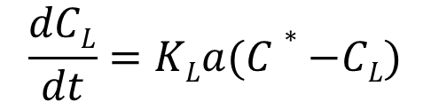
$$\frac{dCL}{dt}=KLa(C∗−CL)$$
K_{L} may be considered as the sum of the reciprocals of the resistances to the transfer of oxygen from gas to liquid
(C*-C_{L}) considered as driving force across the resistances.
‘K_{L}a’ volumetric mass transfer coefficient (units h-1)
This volumetric mass transfer coefficient is used to measure the aeration capacity of the fermenter
K_{L}a is affected by variables such as aeration rate, agitation rate and impeller design.

Slide 8
Determination of K_{L}a values
Sulphite oxidation technique
Gassing out technique
Static method of gassing out
Dynamic method of gassing out
Oxygen balance technique

Slide 9
Sulfite oxidation technique
This technique doesnot require measurement of dissolved oxygen concentrations but relies on the rate of conversion of sodium sulphite to sodium sulphate in presence of copper or cobalt catalyst
Na₂S0₃ + 0.50₂ = Na₂S0₄
Since the dissolved oxygen concentration, is zero then the K_{L}a may then be calculated from the equation:
dC_{L} / dt = OTR= K_{L}a . C* (i)
K_{L}a = OTR/ C*
where OTR is the oxygen transfer rate

Slide 10
Gassing out technique
Gassing out techniques depends on monitoring the increase in dissolved oxygen concentration of a solution during agitation and aeration.
To monitor the increase in dissolved oxygen over an adequate range is necessary first to decrease the oxygen level to a low value.
Two methods – to achieve this lowering of the dissolved oxygen concentration.

Slide 11
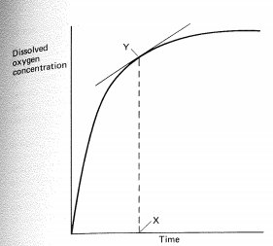
Static method
First described by Wise (1951),
The oxygen concentration of the solution is lowered by gassing the liquid out with nitrogen gas, so that the solution is 'scrubbed' free of oxygen.
The deoxygenated liquid is then aerated and agitated and the increase in dissolved oxygen monitored using some form of dissolved oxygen probe.
The increase in dissolved oxygen concentration is given by –
dC_{L} / dt = K_{L}a(C*-C_{L}) (ii)
Taking logarithm after Integration of equation (ii) we have
ln(C*- C_{L}) = - K_{L}a.t

Slide 12
A plot of the In(C* - C_{L}) against time of aeration, the slope of which equals -K_{L}a.

Slide 13
Fig.1. Dynamic gassing out for the determination of KLa values. Aeration was terminated at point A and recommenced at point B.
Procedure involves stopping the supply of air to the fermentation which results in a linear decline in dissolved oxygen concentration.
At point B the aeration is resumed until it reaches concentration X.
Observed increase in dissolved oxygen concentration is the difference between transfer of oxygen into solution and the uptake of oxygen by respiring culture

Slide 14
Dynamic gassing out method
OTR = dC_{L} / dt = K_{L}a(C*-C_{L}) – xQO₂ ₋₋₋₋₋₋₋₋(iii)
Where,
x is the concentration of biomass and
QO₂ is the specific respiration rate (mmoles of oxygen g-l biomass h- I).
The term xQO₂ is given by the slope of the line AB in Fig -1.
Equation (iii) may be rearranged as:
C_{L} = -1/K_{L}a{(dC_{L} / dt)+ xQO₂}+C* ----------------(iv)
Now from equation (iv), a plot of C_{L} versus dCL/dt + xQO₂ will yield a straight line, the slope of which will equal -1/K_{L}a, as shown in Fig. 2.

Slide 15
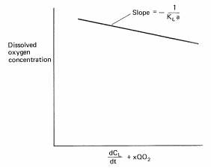
Fig. 2 . The dynamic method for determination of K_{L}a values. The information is gleaned from Fig.1. by taking tangents of the curve, BC, at various values of CL'
Fig. 3. The occurrence of oxygen limitation during the dynamic gassing out of a fermentation.

Slide 16
Advantages
The dynamic gassing-out method has the advantage over the previous methods of determining the KLa during an actual fermentation and may be used to determine K L a values at different stages in the process.
The technique is also rapid and only requires the use of a dissolved-oxygen probe, of the membrane type.
Limitations
A major limitation in the operation of the technique is the range over which the increase in dissolved oxygen concentration may be measured.
It may be difficult to apply the technique during a fermentation which has an oxygen demand close to the supply capacity of the fermenter.
Both the dynamic and static methods are also unsuitable for measuring KLa values in viscous systems.

Slide 17
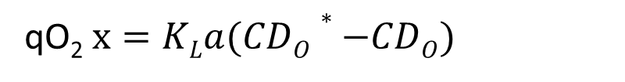
A bioreactor has an oxygen mass transfer coefficient capability of 400 h⁻¹. What is the maximum concentration of E. coli that can be grown aerobically in this reactor. Respiration rate of E. coli is 0.35 g O2 (g Cell)⁻¹ h⁻¹. Critical oxygen concentration is 0.2 mg/L. Assume oxygen saturation with air to be 6.7 mg/L.
If oxygen being supplied is in exact balance with the oxygen consumed by the cells, we expect the dissolved oxygen concentration to remain constant; that is, the derivative will vanish. That is,
qO₂$x=KLa(CDO∗−CDO)$

Slide 18
Oxygen-balance technique
Use to measure K_{L}a during fermentation process.
The amount of oxygen transferred is determined, directly into solution in a set time interval.
The procedure involves measuring the following parameters;

Slide 19
The procedure involves measuring the following parameters:
(i) The volume of the broth contained in the vessel,VL (dm³).
(ij) The volumetric air flow rates measured at the air inlet and outlet, Qi and Qo' respectively (dm³ min~ 1).
(iii) The total pressure measured at the fermenter air inlet and outlet, Pi and Po, respectively (atm. absolute).
(iv) The temperature of the gases at the inlet and outlet, 1; and To, respectively (K).
(v) The mole fraction of oxygen measured at the inlet and outlet, Yi and Yo' respectively.

Slide 20
The oxygen transfer rate may then be determined from the folIowing equation (Wang et al., 1979):
OTR = (7.32 X 1Q⁵/V_{L} )(QiPiyi/Ti - QoPoyo/To) --------------(v)
Where 7.32 X 10⁵ is the conversion factor equalIing (60min h ~l) [mole/22.4 dm3 (STP)] (273 K/l atm).
These measurements require accurate flow meters, pressure gauges and temperature-sensing devices as welI as gaseous oxygen analysers.
The ideal gaseous oxygen analyser is a mass spectrometer analyser which is sufficiently accurate to detect changes of 1 to 2%.

Slide 21
The KLa may be determined, provided that CL and C* are known, from equation(1) :
dC_{L} / dt = KLa(C*-C_{L})
Or OTR =K_{L}a (C*-C_{L})
Or K_{L}a = OTR/(C*-C_{L})
The oxygen-balance technique appears to be the simplest method for the assessment of K_{L}a and
Has the advantage of measuring aeration efficiency during a fermentation.

Slide 22
FACTORS AFFECTING K_{L}a VALUES IN FERMENTATION VESSELS
A number of factors have been demonstrated to affect the KLa value. Such factors include
the air-flow rate employed in vessels,
the degree of agitation inside vessels ,
the rheological properties of the culture broth and
the presence of antifoam agents.

Slide 23
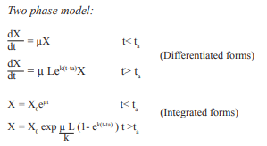

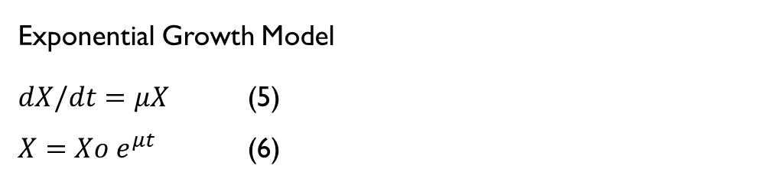
Growth Kinetics
Linear Growth Model
$dX/dt=K$ (1)
$X=Kt+Xo$ (2)
Logistic Growth Model
$\frac{dX}{dt}=μX\left(1−\frac{X}{Xm}\right)$ (3)
$X=\frac{Xm}{\begin{aligned}1+\left(\left(\frac{Xm}{Xo}\right)−1\right)e^{−µt}\end{aligned}}$ (4)
Exponential Growth Model
$dX/dt=μX$ (5)
$X=Xo e^{μt}$ (6)

Slide 24
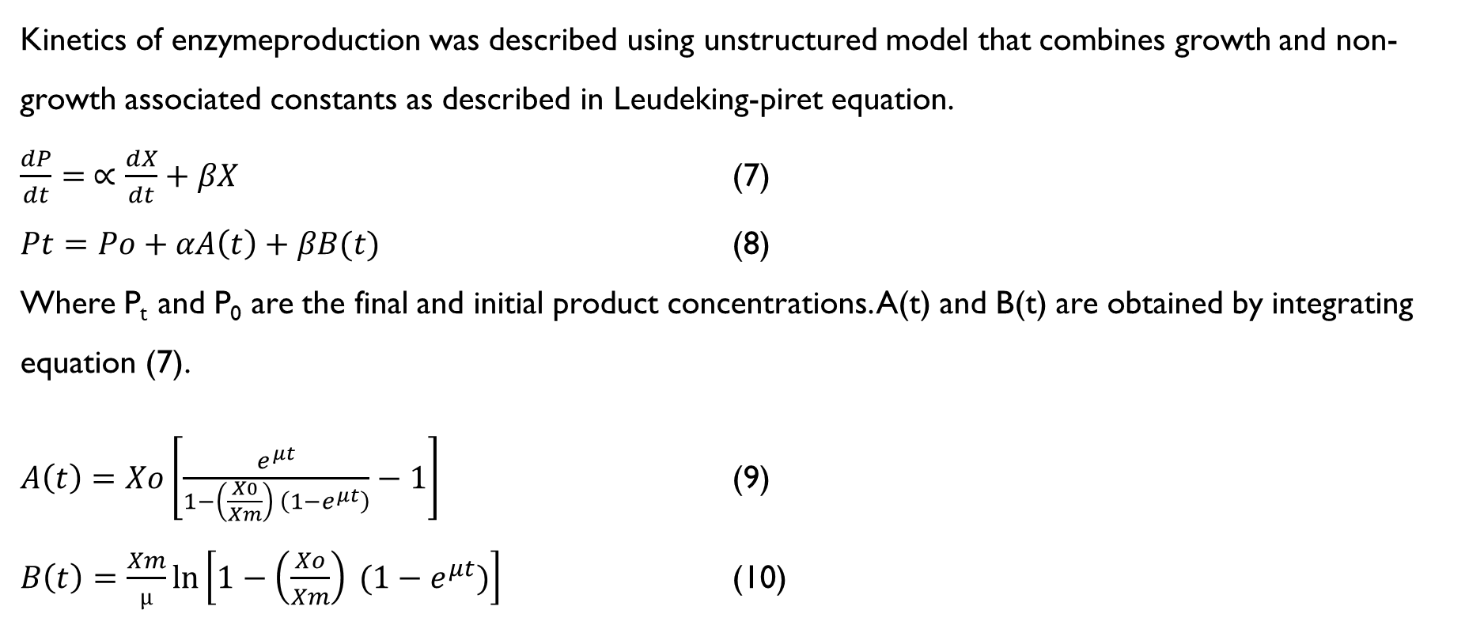
Kinetics of enzymeproduction was described using unstructured model that combines growth and non-growth associated constants as described in Leudeking-piret equation.
$\frac{dP}{dt}= ∝\frac{dX}{dt}+βX$ (7)
$Pt=Po+αA\left(t\right)+βB(t)$ (8)
Where P_{t} and P₀ are the final and initial product concentrations. A(t) and B(t) are obtained by integrating equation (7).
$A\left(t\right)=Xo\left[\frac{e^{μt}}{1−\left(\frac{X0}{Xm}\right) \left(1−e^{μt}\right)}−1\right]$ (9)
$B\left(t\right)=\frac{Xm}{µ}\ln\left[1−\left(\frac{Xo}{Xm}\right) (1−e^{μt})\right]$ (10)
The parameter ∝ in the above linear expression is the growth associated constant and β is the non-growth associated coefficient of product formation.
By plotting (P_{t}-P_{o})/B(t) versus A(t)/B(t) which is a straight line with slope ∝ and intercept β

